Slide 1





Chapter 14.
Linear Algebra and Systems of Linear Equations
(-3,1)

Slide 2
CHAPTER OUTLINE
1
Basics of Linear Algebra
2
Linear Transformations
3
Systems of Linear Equations
(-3,1)
4
Solutions to Systems of Linear Equations
5
Solve Systems of Linear Equations in Python
6
Matrix Inversion
7
Summary and Problems

Slide 3
BASICS OF LINEAR ALGEBRA
What is Linear Algebra?
The study of vectors, matrices, and linear transformations between them.
Foundation of many fields: data analysis, engineering, machine learning, physics.
In numerical computation, linear algebra helps solve systems of equations and model transformations efficiently.
(0,4)
(1,2)
(2,0)

Slide 4
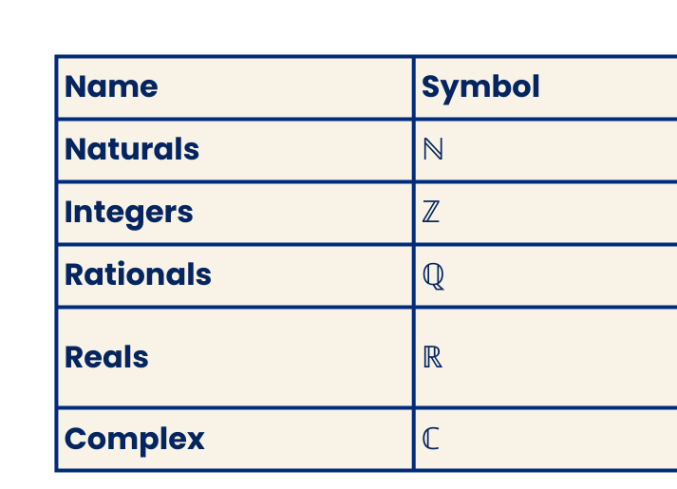
BASICS OF LINEAR ALGEBRA
Sets
Definition:
A set is a collection of distinct objects written in braces {}.
Example: S = {orange, apple, banana}
The empty set: {} or ∅.
Operations:
Union: A ∪ B → elements in either A or B.
Intersection: A ∩ B → elements common to A and B.
Set difference: A \ B → elements in A not in B.
Common sets of numbers:

Slide 5





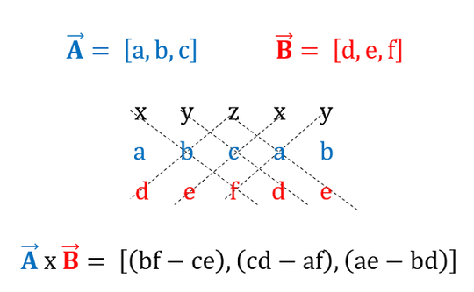
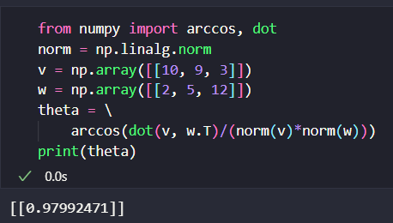
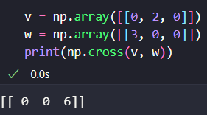
BASICS OF LINEAR ALGEBRA
Vectors
Definition:
A vector is an ordered list of numbers, representing magnitude & direction.
Example:
In ℝ² → (x, y)
In ℝ³ → (x, y, z)
Notation:
Column vector:
Row vector: [1, 2, 3]
Addition:
Scalar Multiplication:
Dot Product: Angle Formula:
Cross Product:

Slide 6
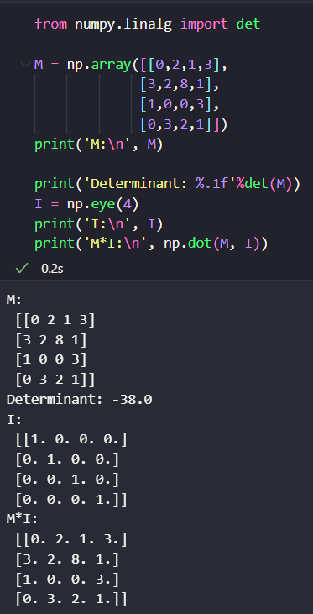
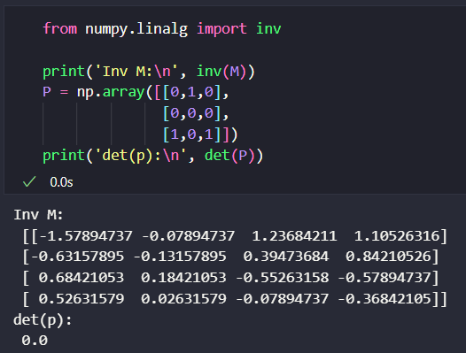
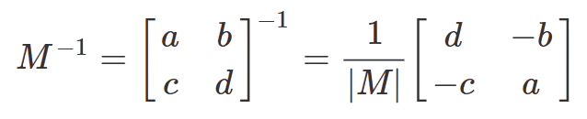
BASICS OF LINEAR ALGEBRA
Matrices
Determinant (square matrices only):
2×2: |M| = ad − bc
3×3: aei + bfg + cdh − ceg − bdi − afh
Identity Matrix (I):
Diagonal ones, zeros elsewhere
Invers Matrix:

Slide 7
LINEAR TRANSFORMATIONS
A linear transformation is a function F satisfying:
F(ax+by)=aF(x)+bF(y)
for all scalars a, b and vectors x, y.

Slide 8
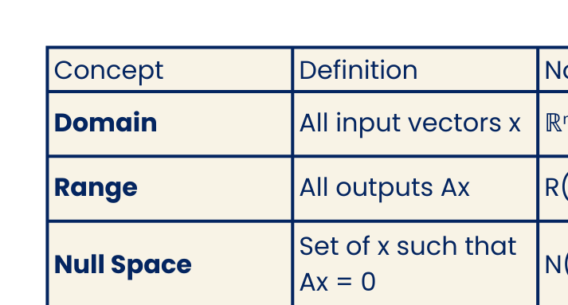
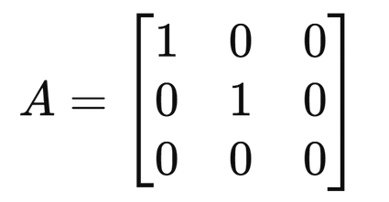
LINEAR TRANSFORMATIONS
Matrix as Linear Function
Matrix multiplication itself is a linear transformation:
F(x)=A⋅x
A: m×n matrix
x: n×1 vector
Result F(x): m×1 vector
Domain, Range, and Null Space
Let
Domain: ℝ³
Range: x–y plane (z=0)
Null space: z-axis (all [0,0,z])

Slide 9
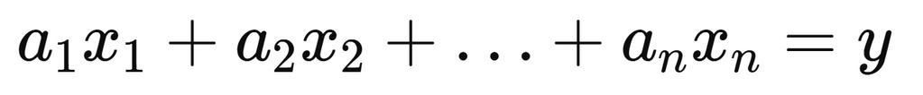
SYSTEMS OF LINEAR EQUATIONS
A linear equation is of the form:
aᵢ → coefficients
xᵢ → unknowns
y → constant (scalar)
Example: 3x + 4y − 3z = −5 → linear.
(x,y)

Slide 10
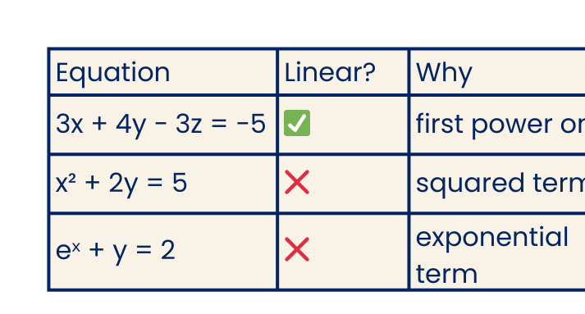
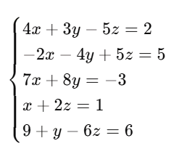
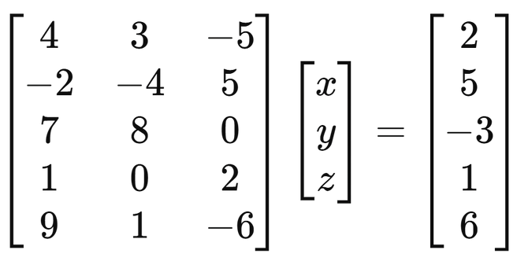
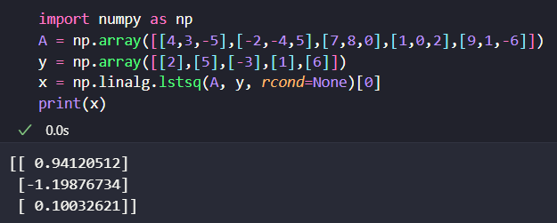
LINEAR TRANSFORMATIONS
Linear vs Nonlinear
Systems of Equations
A system = multiple linear equations with same variables.
Matrix Representation
System → matrix form: A·x = y

Slide 11
LINEAR TRANSFORMATIONS
RECALL
Graph y= -2x + 4.
1
(0,4)
Plot the y-intercept.
b
4
(0,4)
(1,2)
2
Use the slope to find at least two other points.
(2,0)
m
rise = -2
m =
-2
run = 1
3
Draw a straight line through the points.

Slide 12

Graph y = 2x + 1.
m
rise = 2
b
1
(0,1)
m =
2
run = 1
EXAMPLE 1
  (2,4)
Solve the system of linear equations by graphing:
  (1,3)
  (0,1)
y = 2x + 1
{
y = -x - 2

Slide 13
Graph y = -x - 2
m
rise = -1
b
-2
(0,-2)
m =
-1
run = 1
EXAMPLE 1
Solve the system of linear equations by graphing:
y = 2x + 1
  (0,-2)
{
y = -x - 2
  (1,-3)
  (2,-4)

Slide 14
Find the intersection.
The solution is (-1,-1).
EXAMPLE 1
Solve the system of linear equations by graphing:
y = 2x + 1
  (-1, -1)
{
y = -x - 2

Slide 15
SOLUTIONS TO SYSTEMS OF LINEAR EQUATIONS
Definition:
A system of linear equations consists of multiple equations that can be written in matrix form as Ax=b.
Objective:
Find the vector xxx that satisfies all equations simultaneously.

Slide 16
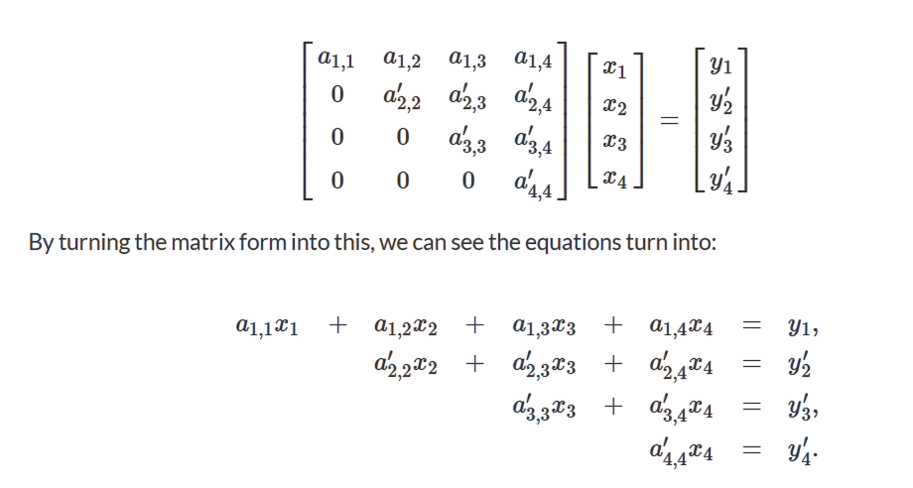
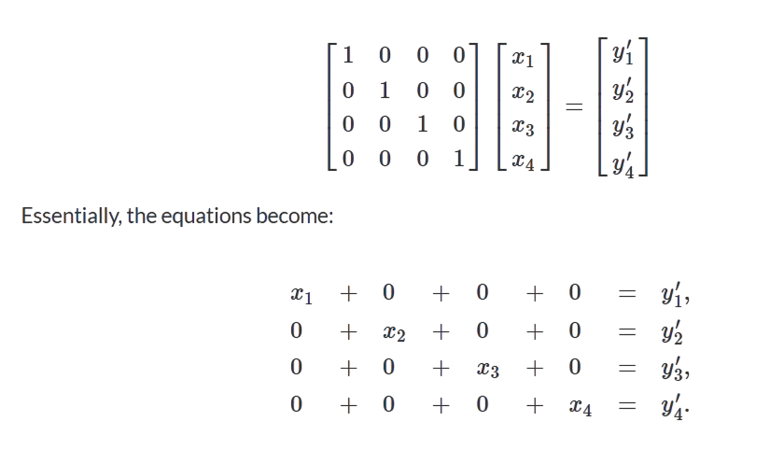
SOLUTIONS TO SYSTEMS OF LINEAR EQUATIONS
Methods for Solving
Direct Methods
Compute the exact solution.
  Gaussian Elimination: transforms the matrix into an upper triangular form.
2. Gauss-Jordan Elimination: reduces the matrix further to diagonal form.

Slide 17
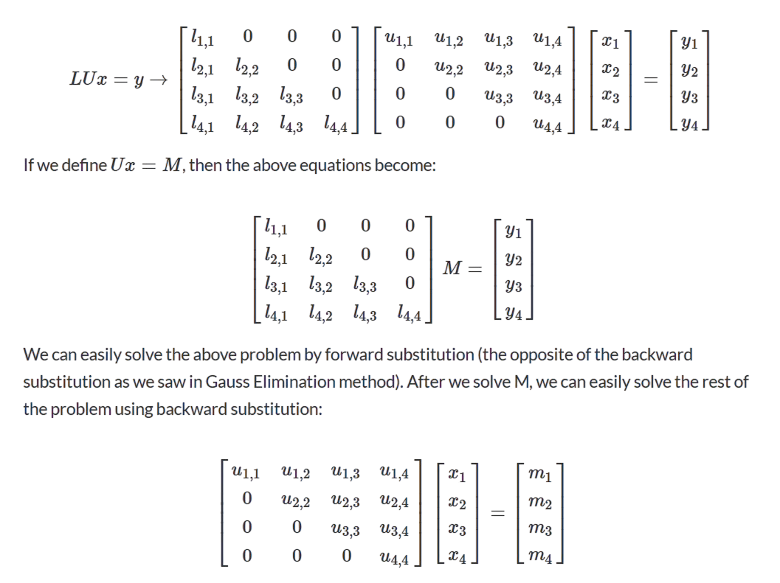
SOLUTIONS TO SYSTEMS OF LINEAR EQUATIONS
Methods for Solving
3. LU Decomposition: factors A into L (lower) and U (upper) matrices for
efficient solving.

Slide 18
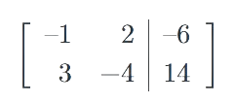



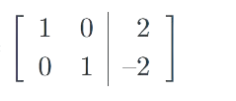
SOLUTIONS TO SYSTEMS OF LINEAR EQUATIONS
Methods for Solving
Example:
–𝑥+2⁢𝑦=–63⁢𝑥
–4⁢𝑦=14
B1.-1
B2-3B1
B2:2
B1+2B2
So,
𝑥+0⁢𝑦=20⁢
𝑥+𝑦=−2
𝑥=2
𝑦=–2

Slide 19
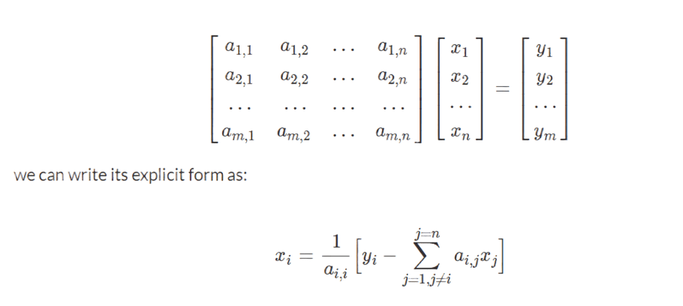
SOLUTIONS TO SYSTEMS OF LINEAR EQUATIONS
Methods for Solving
Iterative Methods
Approximate the solution.
  Gauss-Seidel Method: uses the most recent updated values during iteration.
Matrix Properties
  The system has a unique solution if the determinant of A is nonzero.
  If det(A)=0\text{det}(A) = 0det(A)=0, the system may be inconsistent or have infinite solutions.

Slide 20
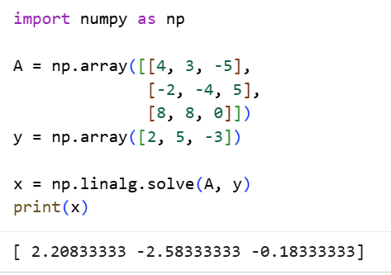
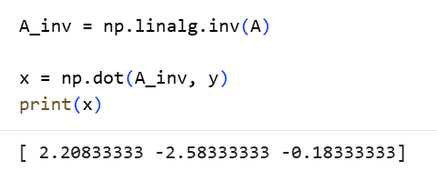
SOLVE SYSTEMS OF LINEAR EQUATIONS IN PYTHON
Solving a 3×3 Linear System with NumPy
Output gives the values of x1, x2, x3
Alternative Method: Matrix Inversion Approach
Matrix inversion gives the same solution, but it’s less efficient

Slide 21
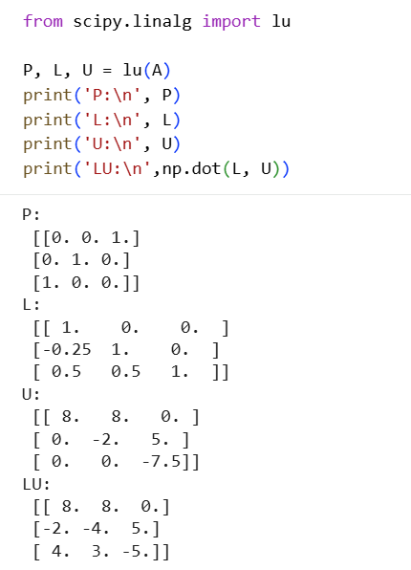
SOLVE SYSTEMS OF LINEAR EQUATIONS IN PYTHON
Getting LU (PA) using SciPy
P = Permutation matrix
L = Lower triangular matrix
U = Upper triangular matrix
LU = It confirms that the LU decomposition was performed correctly

Slide 22
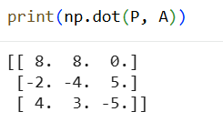
SOLVE SYSTEMS OF LINEAR EQUATIONS IN PYTHON
Checking the Effect of the Permutation Matrix
The reordered matrix PA matches the product LU

Slide 23
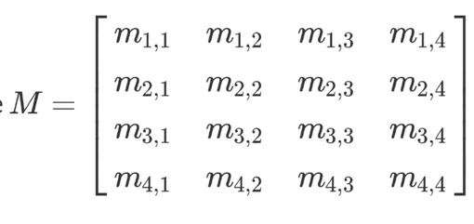
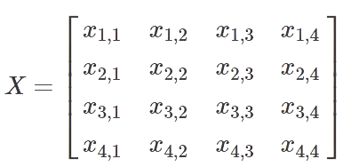
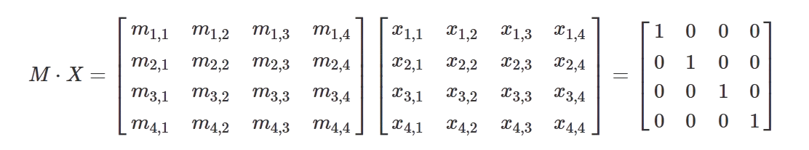
MATRIX INVERSION
Inversion and Identity
A matrix inverse M^-1 is defined only for square matrices and satisfies:
For larger matrices, directly computing the inverse using algebraic formulas becomes impractical — so numerical methods are needed.
M⋅M^−1=M^−1⋅M= I
Case for 4x4 matriks:
One approach: treat each column of the inverse as the solution to a linear system.
and the inverse of M is.
therefore, we will have:

Slide 24
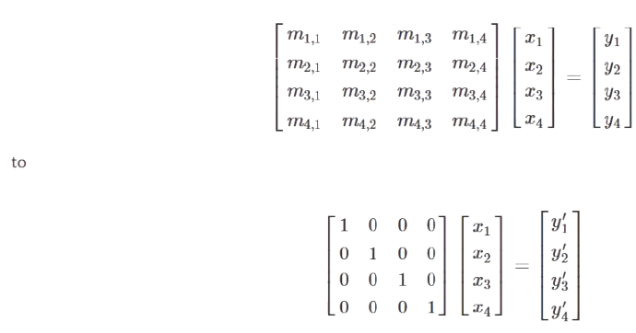
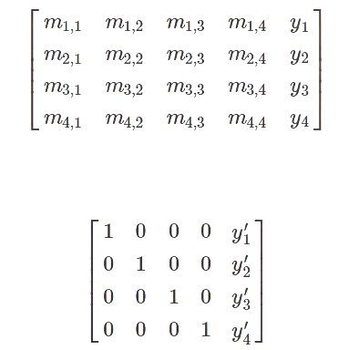
MATRIX INVERSION
Inversion and Identity
Mx1​=e1​,Mx2​=e2​,Mx3​=e3​,Mx4​=e4​
where each ei​ is a column of the identity matrix. The solutions x1,x2,x3,x4 form the columns of M^-1
Therefore, if we solve the above four system of equations, we will get the inverse of the matrix. We can use any method we introduced previously to solve these equations, such as Gauss Elimination, Gauss-Jordan, and LU decomposition. Here, we will just show an example of matrix inversion using Gauss-Jordan method.
Recall that, in Gauss-Jordan method, we convert our problem from
  Recall that, in Gauss-Jordan method, we convert our problem from
2. and get the solution. Essentially, we are converting
To:
To:

Slide 25
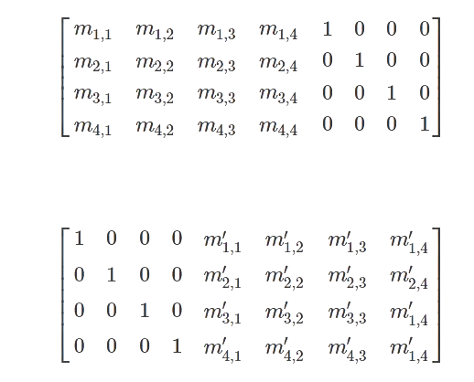
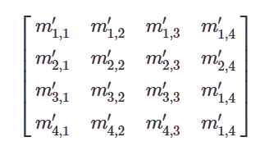
MATRIX INVERSION
Inversion and Identity
3. Let us generalize it here, all we need to do is to convert, Create an augmented matrix [ M | I ]
4. Perform row operations until the left side becomes I
→ the right side becomes M^-1
Then the matrix
is the inverse of M we are looking for.

Slide 26
SUMMARY AND PROBLEMS
Summary
1
Linear algebra is the foundation of many engineering fields
2
Vectors can be considered as points in R^3; addition and multiplication are defined on them, although not necessarily the same as for scalars.
3
A set of vectors is linearly independent if none of the vectors can be written as a linear combination of the others.
4
Matrices are tables of numbers. They have several important properties including the determinant, rank, and inverse.
5
system of linear equations can be represented by the matrix equation Ax=y.
6
The number of solutions to a system of linear equations is related to the rank(A) and the rank([A,y]). It can be zero, one, or infinity.
7
We can solve the equations using Gauss Elimination, Gauss-Jordan Elimination, LU decomposition and Gauss-Seidel method.
8
We introduced methods to find matrix inversion.

Slide 27

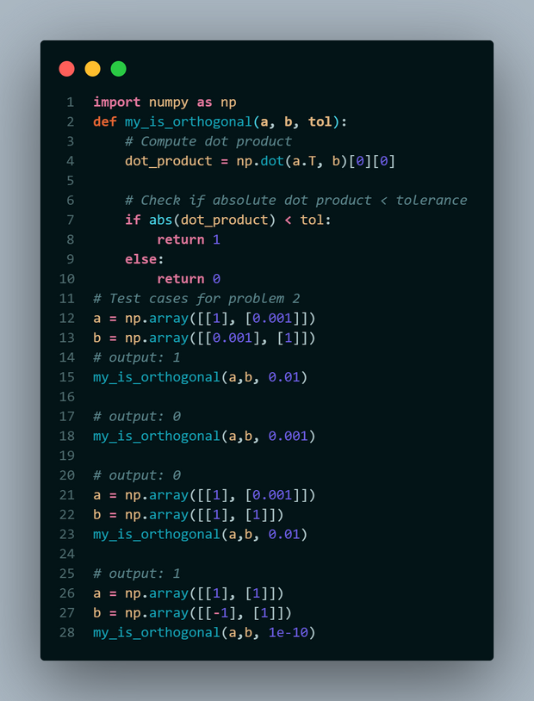

SUMMARY AND PROBLEMS
Problems that might exist, xixixi
1
Show that matrix multiplication distributes over matrix addition: show A(B+C)=AB+AC assuming that A,B, and C are matrices of compatible size.
2
Recognize orthogonality using dot products and norms.
  1 if the angle between vectors is close to 90° (within tolerance)
  0 otherwise
Math used:
Code:
Output:
And 8 more to go (not enough time)...

Slide 28








TERIMA KASIH.

